Slide 1
Senate Bill 1 Training
Last updated:
02.18.2022

Slide 2
Outline
Overview
Helpful resources
Discrete changes:
Pre-filling VR forms
Update VR electronically
Drive thru voting
Curbside voting
Prohibition on soliciting VBM forms
Providing assistance
DPS voter registration checks
Early voting hours

Slide 3
Outline
Larger changes:
VBM ID Numbers
VBM Curing
VBM Assistance
Vote harvesting
Poll watchers

Slide 4
Overview
What this is:
Most important changes in SB1
The “known knowns” and the “known unknowns”
What this isn’t:
Every provision in SB1
Every change to election laws enacted in 2021
The “unknown unknowns”

Slide 5
Helpful Resources
SB 1 Summary (extended version): https://tinyurl.com/TXSB1Summary
SB 1 Summary (short version): https://tinyurl.com/ShortSB1Summary
Presentation on 2021 changes to VR laws:
https://tinyurl.com/TexasVoterRegistrationChanges
Have voters call the Hotline! 866-OUR-VOTE

Slide 6
Pre-filling VR forms
Prohibits pre-filling certain fields on VR form:
Whether the applicant is a US citizen;
Whether the applicant is a county resident;
Whether the applicant is incapacitated;
Voter’s felony conviction status;
Voter’s Texas DL/ID/SSN number fields, or statement of lack of such numbers

Slide 7
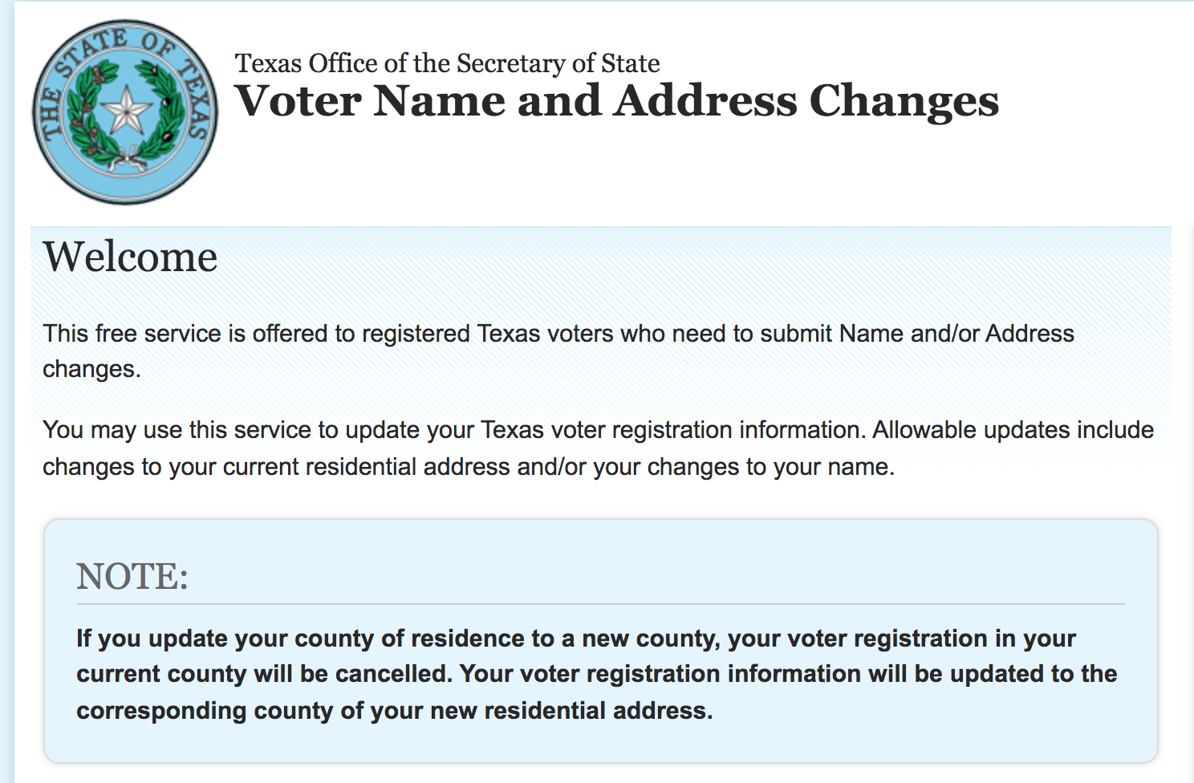
Update VR electronically
Voters can update their registration electronically when they move from one county in Texas to another.

Slide 8
Drive thru voting
No drive through voting:
Prohibition on casting a vote “inside a motor vehicle” unless you are a curbside voter.
Polling places must be “inside” of a “building”
Prohibiting polling places from being in a “movable structure.”

Slide 9
Curbside voting form
You must fill out a new form if you:
Provide transportation to the polling place
To seven or more curbside voters
“Simultaneously”
Form requires:
Name and address
Whether the person is only providing transportation, or also assistance
Does NOT apply if you are related to each of the voters

Slide 10
Prohibition on soliciting VBMs
“Public officials/election officials” CANNOT:
Solicit a VBM app from a person who did not request an application;
Distribute a VBM app to a person who did not request the application
Authorize or approve the expenditure of public funds to facilitate third-party distribution of a VBM app to a person who did not request the application; or
Complete any portion of a VBM app and distribute the application to an applicant.

Slide 11
Prohibition on soliciting VBMs
“Public officials/election officials” CAN:
Provide access to an application on their public website;
Complete portions of a VBM app for a voter if they are “lawfully assisting” the voter
Provide general information about VBM, the VBM process, or the timelines associated w/voting
Engage in the above prohibited conduct while “acting in the official's capacity as a candidate for a public elective office”

Slide 12
Changes to providing assistance
Previously assistant could provide these services:
Answering the voter’s questions
Stating propositions on the ballot
Naming candidates and, if listed, their political parties
Now, assistance limited to:
Reading the ballot to the voter
Directing the voter to read the ballot,
Marking the voter’s ballot
Directing the voter to mark the ballot

Slide 13
Changes to providing assistance
Must also swear new things under penalty of perjury:
The voter “represented to me they are eligible to receive assistance”
“I did not pressure or coerce the voter into choosing me to provide assistance”
“I will not communicate information about how the voter has voted to another person”;
“I understand that if assistance is provided to a voter who is not eligible for assistance, the voter’s ballot may not be counted”

Slide 14
DPS voter reg checks
Monthly DPS voter roll comparisons to “verify” citizenship status.
Codifies Whitley settlement
Those voters flagged by DPS database as non-citizens must submit proof of citizenship
But only if the record from DPS is dated AFTER the person’s voter registration became effective.
Proof of citizenship is one of the following:
Voter’s birth certificate, US passport, certificate of naturalization, or “any other form prescribed by the secretary of state”

Slide 15
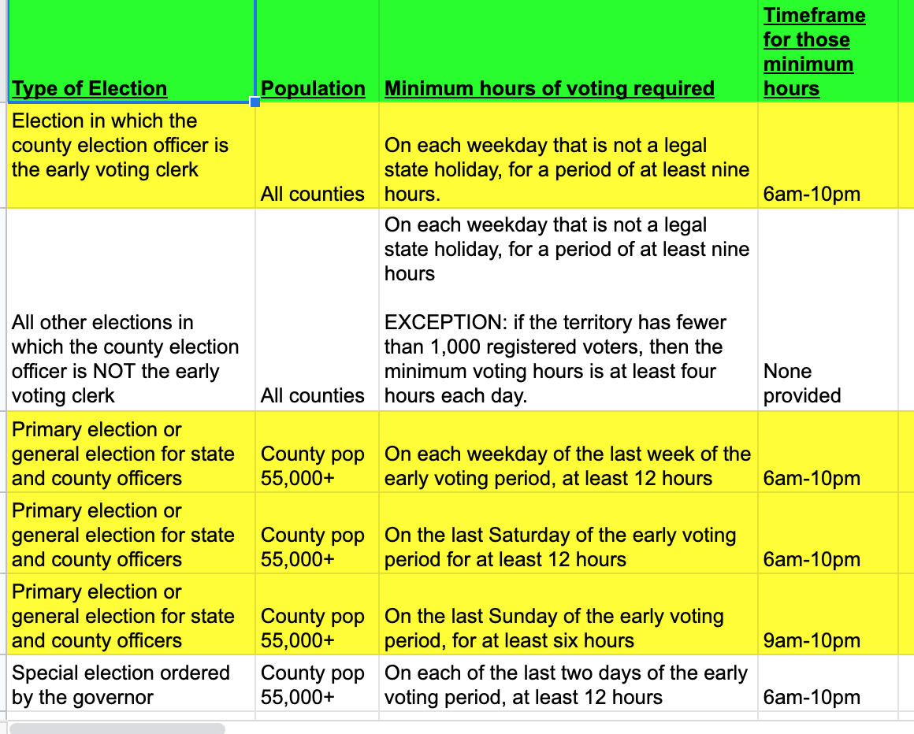
Early voting hours

Slide 16
VBM ID numbers
Three parts to the new rules:
Must provide certain ID #s on your VBM app and return carrier envelope
Rejection if numbers don’t “identify” the voter
Cure process that differs for VBM apps and return envelopes

Slide 17
VBM ID numbers
Must include the following on VBM app/return carrier envelope
Either Texas DL, TX election ID certificate, or TX personal ID card number;
You can use an expired card if it is “otherwise valid”
If you don’t have one of those #s, then the last four digits of your SSN;
Only if you have none of these, you can then check a statement to that effect
You can put both your ID # and SSN to be safe

Slide 18
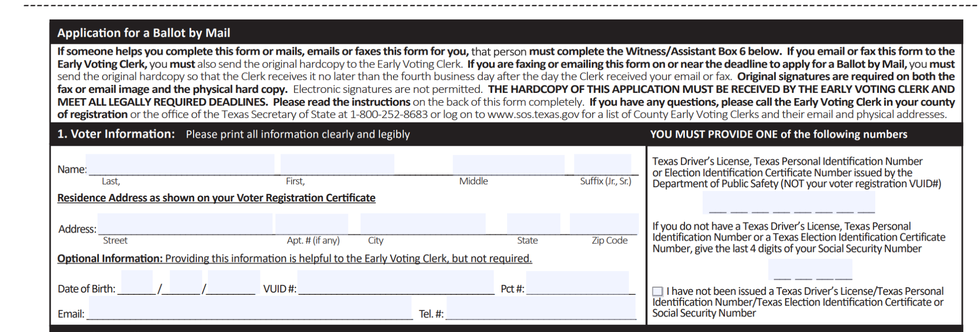
VBM ID numbers

Slide 19
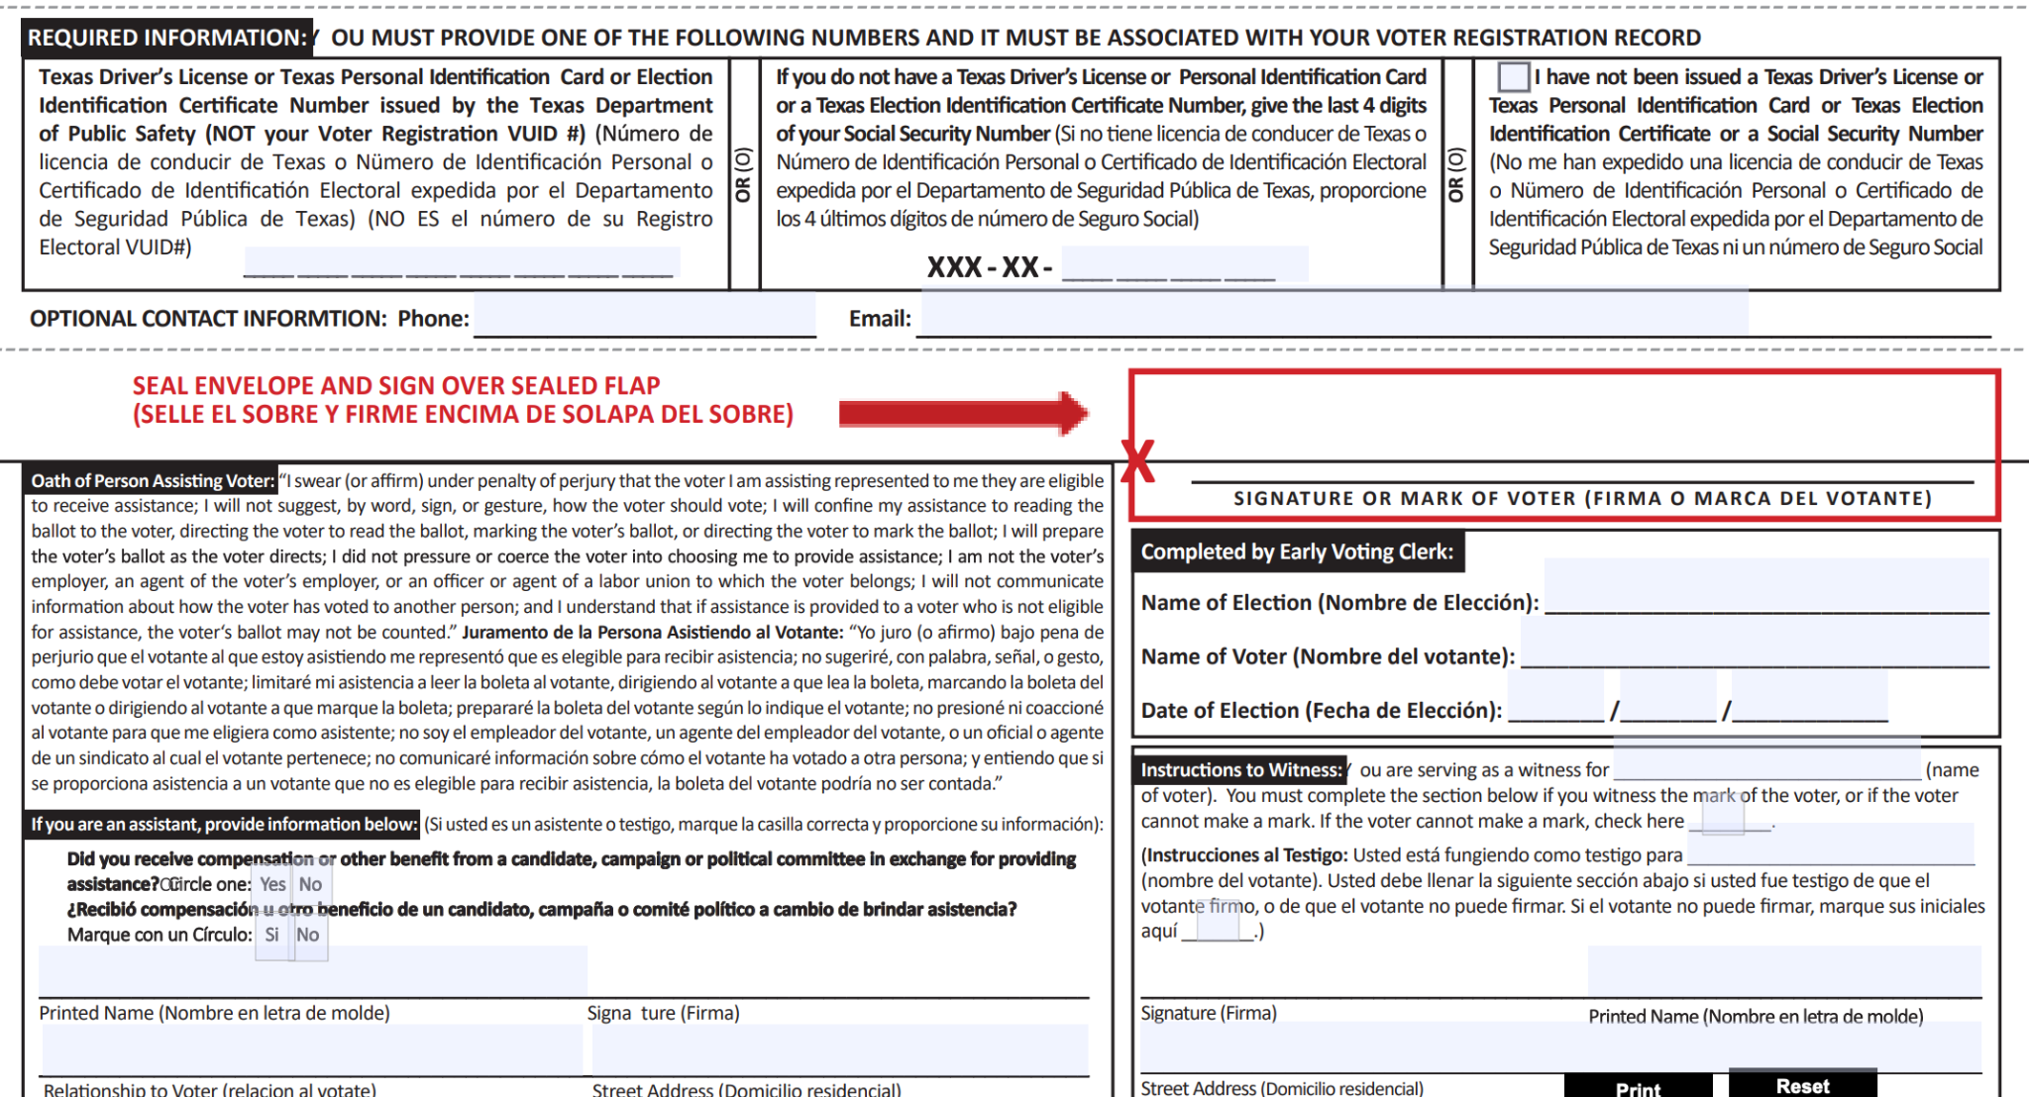
VBM ID numbers

Slide 20
VBM ID numbers
The VBM will be rejected if the number provided doesn’t “identify the same voter identified on the applicant’s application for voter registration”
I.e., the number must match what’s in the individual’s official voter file
The VBM will be rejected if the fields on the form left blank
The VBM will be rejected if an old form is used and no # provided

Slide 21
VBM ID numbers
Curing process for VBM apps:
County must provide notice of the rejection
Notice must include info about the ability to correct or add # on the online VBM tracker.
If a voter uploads a number that “identifies” them, then the county must provide the voter with a VBM ballot.
Curing process for VBM ballots:
Wrapped into general process for curing VBM ballots

Slide 22
VBM curing
New process to notify voters of certain probs w/their VBM ballot and fix
Triggered by the following problems:
Signature issue (failure to sign or mismatch)
Missing a required statement of residence
Incomplete or inaccurate ID numbers
Incomplete information regarding a witness

Slide 23
VBM curing
Curing process differs depending on when the problem is discovered
SVC/EVBB must first determine if it would be possible for the voter to correct the defect and return the envelope before the polls close on election day
If the answer is yes, then SVC/EVBB must return the carrier envelope to the voter by mail
If the issue results from the ID number, voter may enter the correct number on the VBM Tracker, but still must return their ballot to the county by 7:00 p.m. on Election Day.

Slide 24
VBM curing
If the answer is no, then SVC/EVBB MAY but IS NOT REQUIRED TO:
Notify the voter of the defect by telephone or email and
Inform the voter they may either: 1) request their VBM application be canceled or 2) come to the clerk’s office in person within six days of the election to correct the defect.
Voter may also enter the correct ID number on the VBM tracker in lieu of these options.

Slide 25
VBM assistance
Three categories of changes
Expanding requirements of assistance form
Eliminating shield against prosecution of people living in voter’s dwelling
Tightened ban on compensation for depositing/assisting VBM ballots

Slide 26
VBM assistance
Expanding requirements of assistance form
Current fields are:
Signature
Printed name
Residence address
Additional new fields are:
Relationship to the voter
“Whether the person received or accepted any form of compensation or other benefit from a candidate, campaign, or political committee in exchange for providing assistance”

Slide 27
VBM assistance
Partly eliminating shield against prosecution
Person living in the same dwelling as the voter subject to prosecution if they:
Assist a voter to vote by mail; and
Knowingly fail to fill out assistance portion of VBM envelope
Family members who assist VBM voters still shielded from prosecution

Slide 28
VBM assistance
Tightening ban on compensation
Prohibition had been:
No compensation for depositing a VBM ballot or assisting VBM voters as part of a performance-based compensation scheme
Revised prohibition:
No compensation or offer to compensate for depositing a VBM ballot or assisting VBM voters at all, even if not part of a performance-based compensation scheme
EXCEPTION: “an attendant or caregiver previously known to the voter.”

Slide 29
“Vote harvesting”
New criminal offenses if done knowingly:
Providing or offering to provide “vote harvesting services in exchange for compensation or other benefit.”
Providing or offering to provide “compensation or other benefit to another person in exchange for vote harvesting services.”
Collecting or possessing “a mail ballot or official carrier envelope in connection with vote harvesting services.”

Slide 30
“Vote harvesting”
Four elements of vote harvesting services:
In-person interaction;
With one or more voters;
In the physical presence of an official ballot or a ballot voted by mail; and
Intended to deliver votes for a specific candidate or measure.

Slide 31
“Vote harvesting”
The following are NOT considered vote harvesting:
“An activity not performed in exchange for compensation or a benefit”;
“Interactions that do not directly involve an official ballot or ballot by mail”;
“Interactions that do not occur in the presence of the ballot or during the voting process”;
“Interactions that are not conducted in-person with a voter”; or
“Activity that is not designed to deliver votes for or against a specific candidate or measure.”

Slide 32
“Vote harvesting”
A benefit means “anything reasonably regarded as a gain or advantage, including a promise or offer of employment, a political favor, or an official act of discretion, whether to a person or another party whose welfare is of interest to the person.”

Slide 33
Poll watchers: Training
Watchers must complete an online training program developed by SOS.
Training must be available on the Internet at any time without having to register previously
Watcher must present a training certificate when reporting for service.
Must also take a new oath at the beginning of their service:
"I swear (or affirm) that I will not disrupt the voting process or harass voters in the discharge of my duties."

Slide 34
Poll watchers: Removal
Watchers can’t be removed for violating the Election Code or “any other provision of law relating to the conduct of elections” unless an election judge/clerk observed the violation.
A presiding judge can nonetheless call law enforcement to remove a watcher if they “commit a breach of the peace or a violation of law.”
Also doesn’t apply to violations of the Penal Code

Slide 35
Poll watchers: Right of Observation
Newly expanded criminal offense:
“any action to obstruct the view of a watcher or distance the watcher from the activity or procedure to be observed in a manner that would make observation not reasonably effective.”
Watchers may be “near enough to see and hear” the activity they’re trying to observe, except where otherwise prohibited.
Except for being prohibited from being present at the voting station when a voter is preparing their ballot or is being assisted, the watcher “may not be denied free movement where election activity is occurring”

Slide 36
Poll watchers: Right of Observation
Watcher may observe “all election activities relating to closing the polling place”
Watcher may observe “the sealing and transfer of a memory card, flash drive, hard drive, data storage device, or other medium now existing or later developed used by the voting system equipment.”
Watcher can “follow” the transfer of election materials from the polling place to:
A regional tabulating center
The central counting station, or
Any other location designated to process election materials

Slide 37
Conclusion
Contact us anytime!
James Slattery
james@texascivilrightsproject.org
SB 1 Summary (extended version): https://tinyurl.com/TXSB1Summary
SB 1 Summary (short version): https://tinyurl.com/ShortSB1Summary
Presentation on 2021 changes to VR laws: https://tinyurl.com/TexasVoterRegistrationChanges
Have voters call the Hotline! 866-OUR-VOTE

Slide 38
www.texascivilrightsproject.org
www.facebook.com/TexasCivilRightsProject
www.Twitter.com/TXCivilRights

